Slide 1
Reducing Missed
Opportunities for Vaccination (MOV):
Introduction (What have we learned from MOV pilot countries?)
Cambodia MOV workshop
Nov. 27-29, 2017
Notes:
Good afternoon.
My presentation will share with you the results of two missed opportunities assessments that have been conducted in AFRO. So, I'm going to tell you about “What have we learned in Chad and in Malawi?”

Slide 2
Objectives
To share lessons learned from the first pilot countries
To aid discussion on how the MOV strategy has been adapted for Cambodia
To provide context for the next set of presentations which are specific to the evidence of missed opportunities in Cambodia

Slide 3
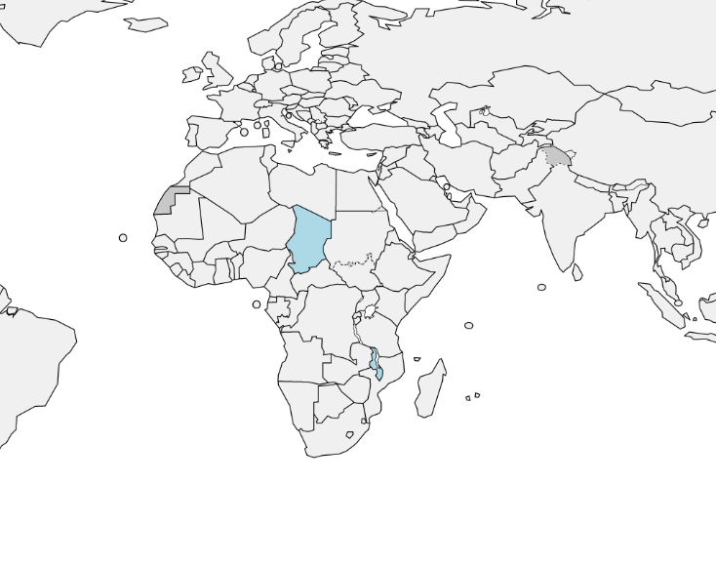
First MOV pilots:
Chad and Malawi (in Africa)

Slide 4
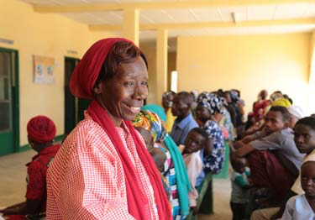
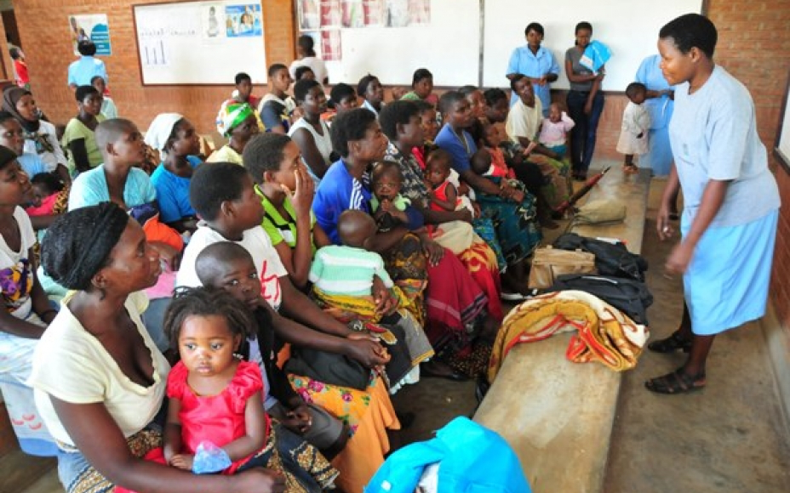

Slide 5
National immunization schedules
Chad
Malawi
Notes:
Before proceeding any further, I thought it would be useful to quickly review the vaccination schedules in the two countries.
Like most countries in the region, Chad and Malawi provide BCG at birth. Subsequent visits occur at 6, 10 and 14 weeks.
Important to note that in Malawi there are more new vaccines (Pneumo and Rota and HPV) in the schedule, as well as additional well-baby visits for Vitamin A supplementation.

Slide 6
What did it take to conduct the MOV assessments in Chad and Malawi?
CHAD
2 days of field work
15 teams of 2 people
6 districts assessed
30 health facilities
MALAWI
3 days of field work
10 teams of 2 people
10 districts assessed
30 health facilities
377 Exit interviews of mothers/caregivers
179 Health care workers interviewed
4 Focus group sessions with mothers/caregivers
4 Focus group sessions health care workers
599 Exit interviews of mothers/caregivers
262 Health care workers interviewed
6 Focus group sessions with mothers/caregivers
6 Focus group sessions health care workers
Notes:
This slide summarizes what it took to conduct the MOV assessments in Chad and Malawi. The aim is for countries to be able to conduct these assessments with minimal technical assistance from partners and within a short timeframe.
I won't go into the details of the MOV assessment methodology (you can find that in the YELLOW BOOK).
But briefly it is a survey (cross-sectional) and uses a purposive sampling. It is not intended to be nationally representative but includes private providers, hospitals as well as vaccination clinics, and urban and rural. The interviews take place during a planned vaccination session and sample children who are 0-23 months old.
In Chad, we had only 2 days of field work (due to security restrictions), but we were able to deploy 15 teams of two people each to 6 districts and 30 health facilities. During the two days, we conducted 377 exit interviews of parents/guardians, 179 health worker interviews, 4 focus group discussions among mothers and 4 among health workers.
Similarly, in Malawi, over 3 days of field work and with 10 teams, we assessed 10 districts and 30 health facilities. This resulted in 599 exit interviews, 262 health worker interviews, and 6 focus group sessions each for mothers and health workers.

Slide 7
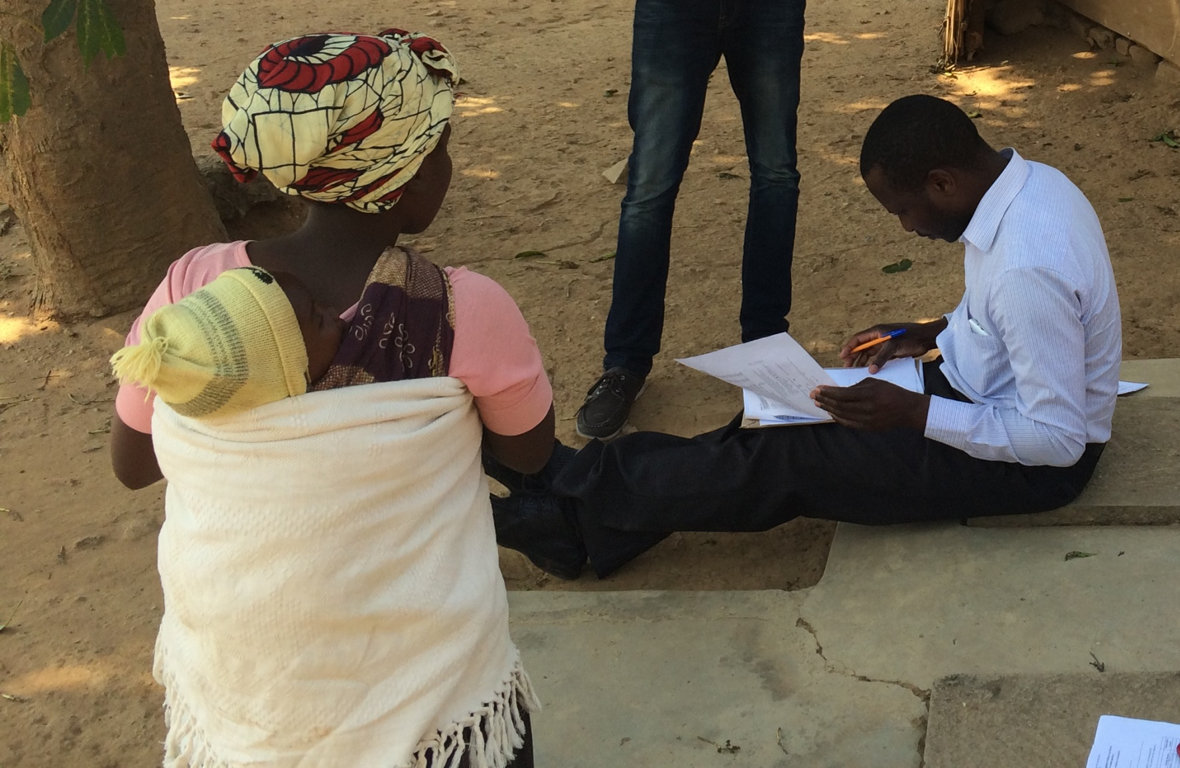
Field staff documenting missed opportunities during interviews with parents/guardians at the exit of health facilities
Notes:
This is a photo of one of the exit interviews being conducted at a health facility in Malawi.

Slide 8
Exit Survey Findings: Malawi
Study population
599
Ineligible
19
Vaccination dates documented
546
Vaccination dates missing
34
Up-to-date at start of visit
276
Not up-to-date 270
Valid contra-indications
0
No contra-indications
270
Received no vaccine during the visit
182
Received at least one vaccine
88
All eligible vaccines given
84
Some eligible vaccines given but some still overdue
4
Eligible
580

Slide 9
Vaccination card availability on the day of the exit interview
 | Chad | Malawi
Number responding to this question | 322 | 549
Yes, and I have it with me today | 63% | 93%
Yes, but I do not have it with me | 22% | 5%
No | 15% | 1%
If card is not with you, why not?
Forgot to bring it | 17% | 17%
Didn’t know it was important to bring it | 15% | 29%
This visit was not for vaccination | 34% | 9%
Note: In Malawi, unlike in Chad, the home-based record is a “health passport” and is required for every type of health service encounter
Notes:
Slide updated 9/8/2017
Assessment of missed opportunities is not possible without a vaccination record. This is because both the date of birth AND a documented vaccination date are necessary for assessing eligibility.
In Chad, only 62% of the interviewed parents/guardians had the home-based record in their possession, compared with 93% in Malawi.
When asked why they did not have the vaccination card, 33% in Chad versus 8% in Malawi said it was because the visit was not for vaccination.
The big difference between these two countries is that Malawi uses a “health passport” ---- which the caregiver must bring with them for every health service visit (for vaccination, treatment, well-baby visit, etc.). So naturally, in Malawi more people had the cards with them.
As a consequence, in Malawi, a greater proportion of children who visited the health facilities for reasons other than vaccination, were included in the analysis because they had their vaccination record on hand. This has an impact on the interpretation of the results.

Slide 10
What proportion of eligible children visiting a health facility were not vaccinated (missed opportunity)?
Exit interviews of parents/caregivers
Chad: 186 with known eligibility Malawi: 585 with known eligibility
After consultation in the health facility, about half of the eligible still did NOT receive the vaccines they needed – 43% in Chad and 57% in Malawi
Proportion of missed children
49
50
1
10
123
183
32
45
38
332
183
32
45
38
298
123
Reason for today’s visit to the health facility
Notes:
This slide shows you the results. First look at the far right column within each block.
Overall, in Chad, 43% of ALL eligible children visiting the health facility were missed. In Malawi it was 57%.
When these missed opportunities are broken down by purpose of the visit (the other columns):
In Chad we see that 89% of children who visited for medical consultation (and were eligible for at least one dose of vaccine), were not vaccinated.
In Malawi, the prevalence of missed opportunities during medical consultation was 67%.
Among those who came to the clinic specifically for VACCINATION, 25% and 23% in Chad and Malawi respectively, remained unvaccinated.

Slide 11
So why are we missing opportunities for vaccination:
Parents’/guardians’ perspective – Chad and Malawi, 2015
For vaccination
There were no vaccines
Other supplies were out of stock
For medical consultation
Vaccination area was closed
Health worker did not ask about other overdue vaccines
Vaccination was not the purpose of this visit
Health worker did not ask about vaccination
Notes:
When asked why they did not receive overdue vaccines, parents/guardians mentioned different reasons, depending on why they attended the clinic.
For children who visited for vaccination, they mentioned that there were no vaccines; other supplies were out-of-stock; and the fact that the health worker did not ask about other overdue vaccines.
For children who were at the health facility for medical consultation, reasons given include that the vaccination area was closed; vaccination was not the purpose of this visit; and that the health worker did not ask about vaccination.

Slide 12
Today my child did NOT received any vaccine because he/she is sick
Diagnosis | Chad | Malawi
Number responding that child was sick | 12 | 10
Diarrhoea | 58% | 0%
Cold and/or cough | 33% | 10%
Malnutrition/anaemia | 25% | 0%
Mild fever | 25% | 10%
Pneumonia (true contraindication; correct response) | 17% | 0%
Dehydration | 8% | 0%
Child is taking medications | 8% | 0%
Intestinal parasites | 0% | 0%
Low birth weight | 0% | 0%
Urinary tract infection | 0% | 0%
Other (“on admission”, three that were “just born”, one treated for fever, one that was told she “needed only medication”, and one that had malaria) | 25% | 90%
Notes:
Slide updated 9/8/2017
For children who did not receive vaccines due to an illness, this table shows the diagnoses that were reported by the parents/caregivers.
Of note is the fact that the only true contraindication on this table is PNEUMONIA. However, more than 50% of the children who were denied vaccines due to an illness reported other minor illnesses which are not true contra-indications. (Multiple responses were allowed for this question).
The “Other” category in Malawi included two children on admission for an unspecified illness, three that were “just born”, one that had just been treated for fever, one that was told she “needed only medication”, and one that had malaria

Slide 13
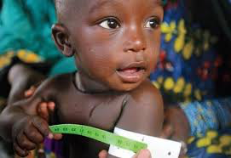
Can the knowledge, attitudes and practices of health care workers contribute to the occurrence of missed opportunities?
Notes:
To further explore the reasons for missed opportunities from the perspective of the health workers, their knowledge, attitudes and practices were assessed.

Slide 14
What do the health care workers believe are contra-indications to vaccination?
Perceived contraindications | Chad | Malawi
For any vaccine
Local reaction to previous dose | 15% | 9%
Mild fever | 35% | 49%
Seizures under medical treatment | 5% | 10%
Pneumonia or other serious diseases (correct response) | 7% | 12%
None of the above | 38% | 20%
For oral polio vaccine
Breastfeeding | 0% | 0%
Axillary or rectal temperature of ≤37.5 °C | 13% | 17%
Mild malnutrition | 9% | 3%
Mild diarrhoea | 9% | 16%
None of the above (this is the correct response) | 61% | 56%
Notes:
Slide updated 9/8/2017
More than a third of the health workers in Chad and Malawi perceived mild fever as a contra-indication for vaccination!
When asked specifically about contra-indications against polio vaccination, more than half of the respondents gave the correct response in both countries.
The difference between Chad (77%) and Malawi (59%) may suggest the benefit of more polio-related trainings in Chad (Chad is still conducting polio NIDs)

Slide 15
Health care workers’ views on why some children are NOT up to date on their vaccination schedule?
Responses | Chad | Malawi
Parents’ negative beliefs about vaccination | 53% | 25%
Parents’ busy lives incompatible with vaccination hours | 8% | 2%
Health workers do not ask parents about children’s vaccination status | 9% | 1%
Health workers do not review vaccination cards | 3% | 7%
Health workers use false contra-indications | 3% | 2%
Distance from vaccination site | 4% | 14%
All of the above (this is the correct response) | 19% | 49%
Notes:
Slide updated 9/8/2017
The healthcare workers also believed that parents’ negative beliefs about vaccination resulted in children not being up-to-date on their vaccination schedules.
They tended to blame the parents more than themselves and other systemic/logistical challenges.

Slide 16
What did we learn from the Focus Group Discussions with caregivers and health care workers?
Mixed levels of satisfaction with vaccination services
  “I would say I am not really satisfied because of the challenges we are facing. The major challenge is distance. Our catchments come from very far. The other challenge is that we are also constrained by poor logistics.” – Healthcare worker
  “At this facility, vaccinations are given during morning hours only. On market days, we fail to come for vaccinations because we have to go to the market first to sell our produce, and by the time we come back from market they have stopped providing vaccination and they say we are late.” - Caregiver

Slide 17
What did we learn from the Focus Group Discussions?
Poor integration of services
  “Health workers believe vaccination is mainly the responsibility of HSAs, so mothers wait a long time for HSAs” – Health facility officer in charge
  “I have never been told to go for vaccinations when my child was sick” – Caregiver
Varied healthworker knowledge and practices
  “I overheard some HSAs discussing on what to do with a child who had not received any vaccine but was over 6 months due, without a proper check” – Caregiver
  “Another reason is the vials. For example, BCG vials contain doses for 20 children. One cannot waste a vial because of a child”– Health facility officer in charge

Slide 18
Summary of reasons for MOVs
Health care workers
Health services
Caregivers
Failure to screen
False contra-indications
Vaccine wastage
Delayed schedules
Limited hours
Over-aged children
Shortage and stock-outs
Lack of integration
Poorly-designed records
Other adverse policies
Vaccine hesitancy
Lack of awareness of schedule
Vaccination card to clinic
Vaccination card availability
Notes:
In summary, the reasons for the occurrence of missed opportunities are primarily due to lack of information, lack of motivation or specific obstacles, with health care workers accounting for two-thirds of the documented missed opportunities:
Among mothers/caregivers, vaccine hesitancy and lack of information on the immunization schedule were reasons for missed opportunities. Also, when caregivers do not bring vaccination cards along to the clinic, health workers are limited in their ability to screen for missing doses.
Reasons related to the health services include limited vaccination hours, shortage of vaccines and stock-outs of vaccines and other supplies.
A lack of integration of vaccination and curative services and poorly designed vaccination records, such as registers with insufficient space for dates and cards with no space for next appointment, also result in missed opportunities. Finally, some outdated national policies may discourage universal vaccination of all eligible children
Health workers account for a disproportionate number of reasons for missed opportunities. These include:
Failure of health workers to regularly screen patients for eligibility at intake
Perceived contra-indications, such as so-called “over-aged” children, mildly ill or underweight children, and multiple injections
Reluctance to vaccinate sick children due to liability issues
Health workers’ knowledge, attitudes and practices related to vaccine wastage; correct dosing intervals and delayed schedules;

Slide 19
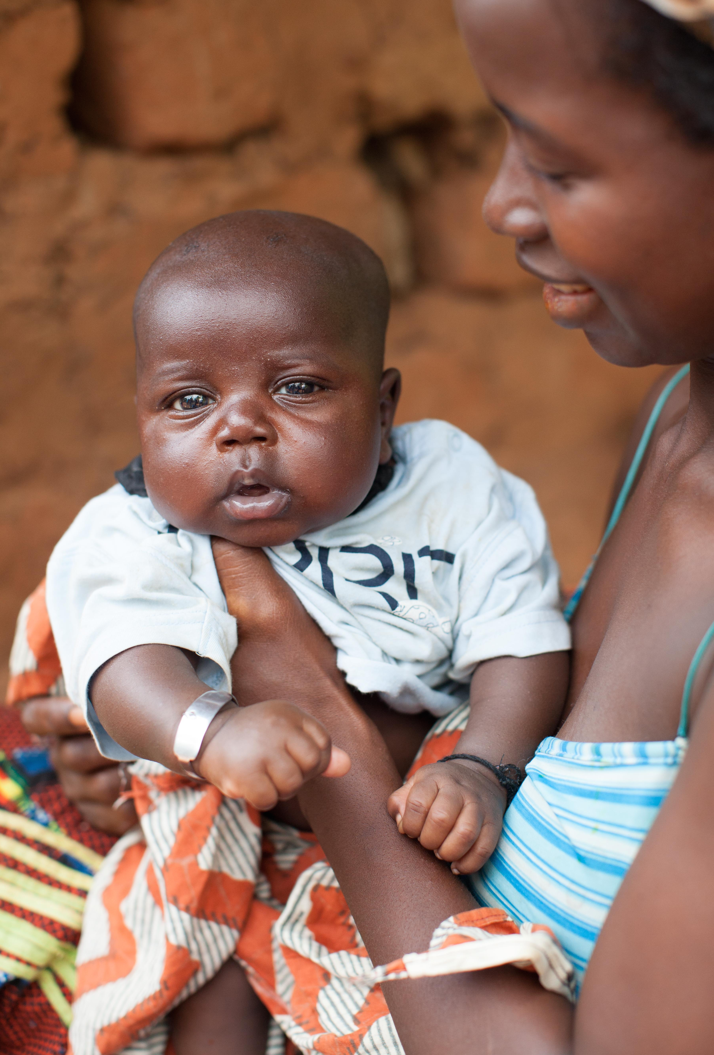
What can we conclude?
Missed opportunities
persist as a problem
Prevalence remains high globally: 32%
  43% in Chad and 57% in Malawi
Reducing MOVs would increase coverage
  Estimated gains in Malawi: 5% in DTP3 and 10% in MCV1
The country-led processes and resulting data generated enthusiasm and buy-in
Each country developed a work plan of activities to reduce MOVs
The full MOV strategy needs to be completed by supporting the implementation of intervention plans
  Including monitoring and evaluation of outcomes and impact
Notes:
So, what can we conclude from these two experiences?
Missed opportunities persist as a problem in both these countries, with about half of the eligible children on a given vaccination day missing the opportunity to be vaccinated.
We estimate that reducing missed opportunities would increase coverage by between 5% to 10% in Malawi, where recent ancillary data were available.
It is also important to emphasize that the process of assessing MOVs in itself was useful in generating enthusiasm from country staff, as well as in improving buy-in for implementing subsequently proposed interventions
Each of these countries has now developed a draft work plan of activities to reduce missed opportunities and they have requested funding and technical assistance for implementation of solutions and interventions.
We now need to ensure that the full MOV strategy is completed by supporting these plans so that they become actions that make a difference.

Slide 20
Malawi’s Three-pronged Approach To Reduce MOVs
Caregiver gaps
Health care worker gaps
Logistic barriers
Address caregiver gaps
Address health care worker gaps
Reduce logistical barriers to immunization

Slide 21
Address Caregiver Gaps
Augment current health talks for parents
  Emphasize importance of bringing health passports
  Encourage proactive vaccination checks at every point of contact with a health service
Orient drama groups to present at health facilities
Increase orientations to community health volunteers

Slide 22
Address Health Care Worker Gaps
Deploy an immunization training module
  Train both immunization and non-immunization staff
Produce and disseminate new job aids
Send monthly letters to health facilities with friendly reminders to conduct daily vaccination sessions
Enhance supportive supervision

Slide 23
Address Logistic Barriers
Malawi MoH to train national, zonal, and district EPI officers in the Stock Management Tool
  Develop a detailed plan to ensure timely distribution of vaccines to the zonal level
Install new Solar Direct Drive (SDD) refrigerators
  Replace all kerosene and gas refrigerators with SDDs

Slide 24
Status of Malawi Implementation
Malawi conducted the MOV assessment in August 2015
Implementation plan included in annual EPI work plan for 2016
  Interventions delayed due to delay in approval of Gavi HSS funds
  Now included in Gavi CEF
WHO and CDC collaborating on a 2YL/MOV strategy, starting in Q1-2018
  Plan is to pilot interventions in two priority districts
Impact evaluation planned for Q2-2019
  Scale-up to other districts with Gavi CEF funds

Slide 25
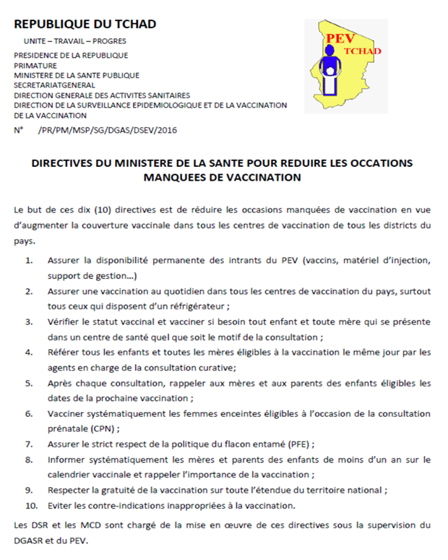
Chad 2015-2017 work plan to reduce MOVs
Directive signed by the Minister, to all HW with 10 actions to reduce MOVs
Training of HWs, including non-immunization staff
Improved supervision and monitoring
Social mobilization of communities and caregivers
  to always bring vaccination cards to all health service encounters
Notes:
Let me end by sharing with you the work plans developed by Chad and Malawi for reducing missed opportunities.
In Chad, the plan includes:
- a directive signed by the Health Minister, addressed to all health workers and outlining 10 actions to reduce missed opportunities;
- training of health workers, including non-immunization staff, on how to reduce missed opportunities;
- improved supervision and monitoring; and
- social mobilization to communities and caregivers to improve awareness of the need to always bring their vaccination cards to all health service encounters.

Slide 26
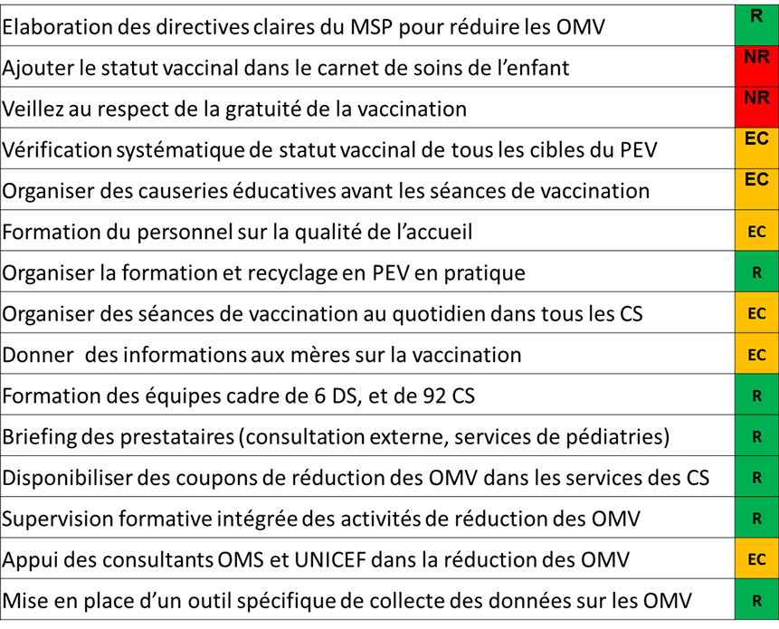
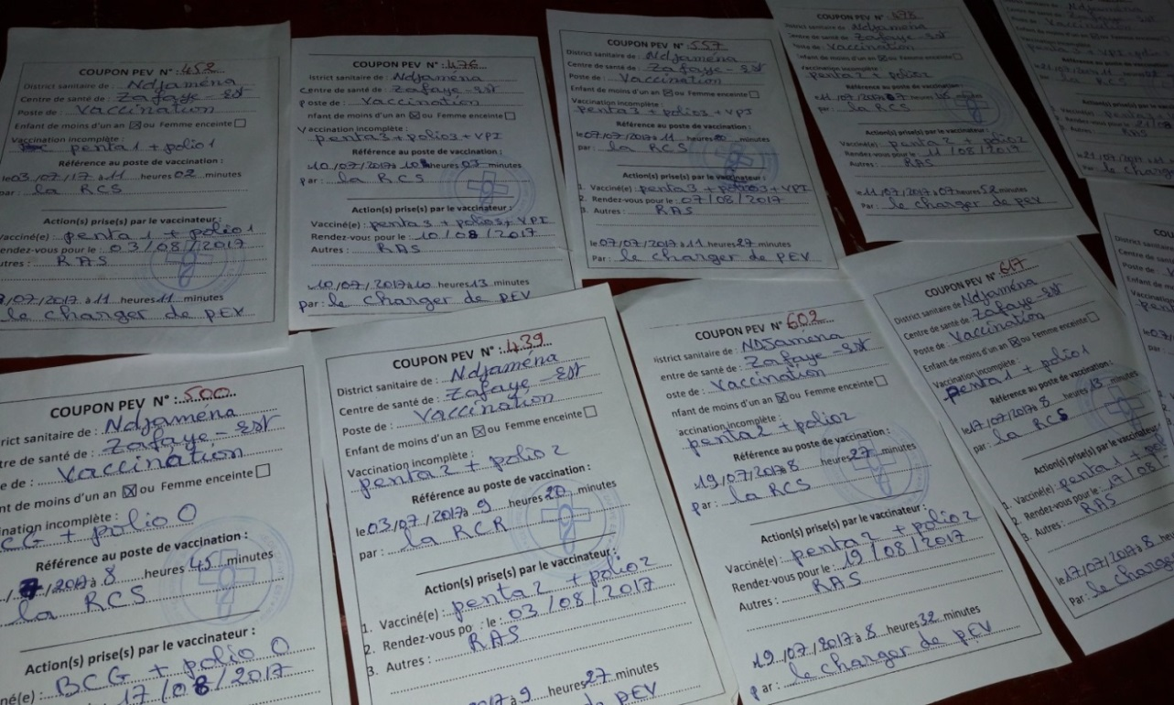
In Chad, this finding led to the adoption of 15 simple strategies to reduce MOV…
…including the issuance of vaccination “coupons” for cross-referral of children who visited for other reasons…
Chad MOH
Notes:
Chad decided to implement 15 strategies to reduce MOV as shown here, including the issuance of vaccination “coupons” for cross-referral of children who visited for other reasons

Slide 27
In the participating districts, this has led to an increase in the number of administered doses
Cross-referral using coupons
Chad MOH
Notes:
This chart shows that in 2 participating districts, in July and Aug this year, implementation of MOV strategy especially the cross referral led to an increase in the number of vaccinated kids compared to same months last year and previous months this year.
Stay tune for more results that Ike and his colleagues will certainly show in the near future.

Slide 28
Thank you
Notes:
Thank you!

